Slide 1



Brain Stroke Prediction Using Machine Learning
This project aims to predict the likelihood of a brain stroke using machine learning techniques. By leveraging patient data and applying appropriate algorithms, we seek to develop a model that can assist healthcare professionals in identifying individuals at risk of stroke.

Slide 2

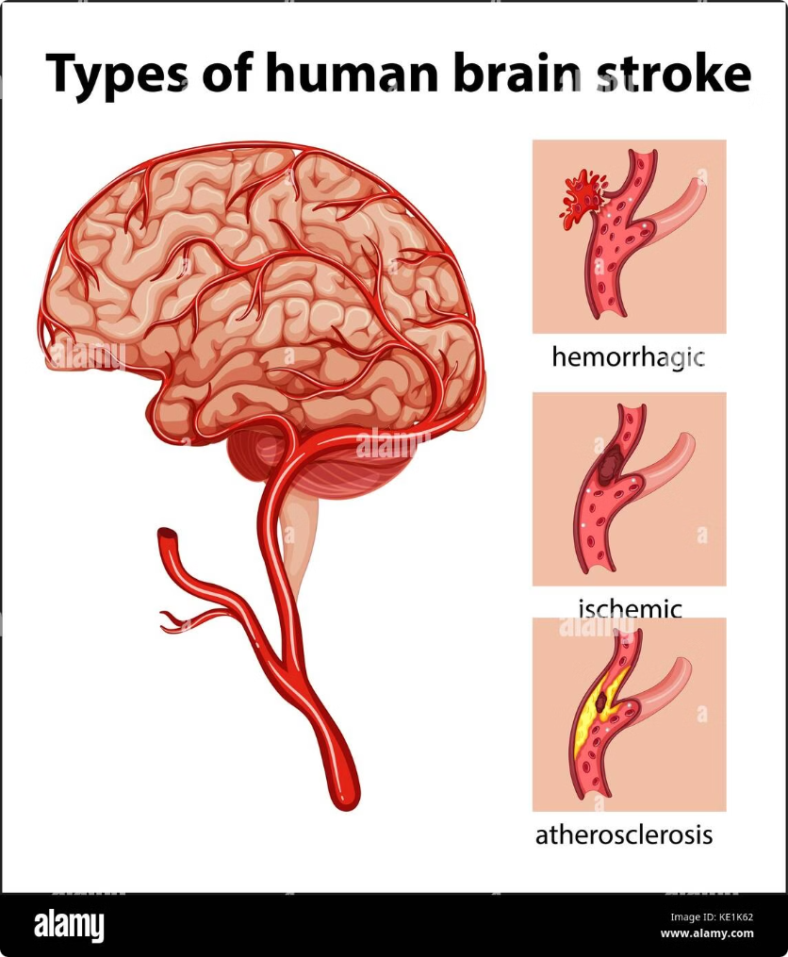
Introduction & Problem Statement
Brain stroke is a serious medical condition that can lead to permanent disability or even death. Accurate and timely prediction of stroke risk is crucial for early intervention and prevention. However, predicting stroke can be challenging due to the complex interplay of various factors.
1
Importance
2
Challenges
Predicting brain stroke is essential for early intervention and prevention, potentially improving patient outcomes.
Predicting stroke involves handling complex data with numerous factors, including patient history, lifestyle, and genetic predispositions.
3
Impact
By leveraging machine learning techniques, we aim to contribute to advancements in stroke prediction and improve patient care.

Slide 3
Objectives
Our primary objective is to develop a machine learning model that can effectively predict the risk of brain stroke based on patient data. By achieving this, we aim to assist healthcare professionals in identifying individuals at risk.
Prediction
Machine Learning
Accuracy
To develop a model capable of accurately predicting the likelihood of a brain stroke using patient data.
To explore the application of machine learning algorithms in the context of healthcare, specifically stroke prediction.
To achieve a model with high prediction accuracy, ensuring reliable predictions and supporting informed decision-making.

Slide 4

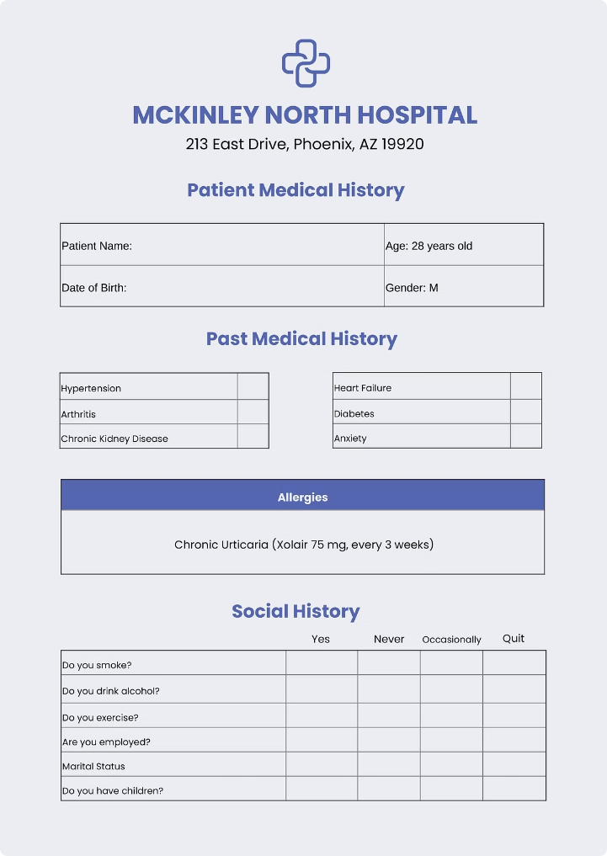
Dataset Description
The dataset used for this project is derived from a publicly available repository. It contains detailed information about patients, including demographic factors, medical history, lifestyle habits, and stroke status. This rich dataset allows for comprehensive analysis and model development.
Feature
Description
Age
Patient's age
Gender
Patient's gender
Hypertension
Whether the patient has hypertension
Heart Disease
Whether the patient has heart disease
Glucose Level
Patient's glucose level
BMI
Patient's body mass index
Smoking Status
Whether the patient smokes

Slide 5

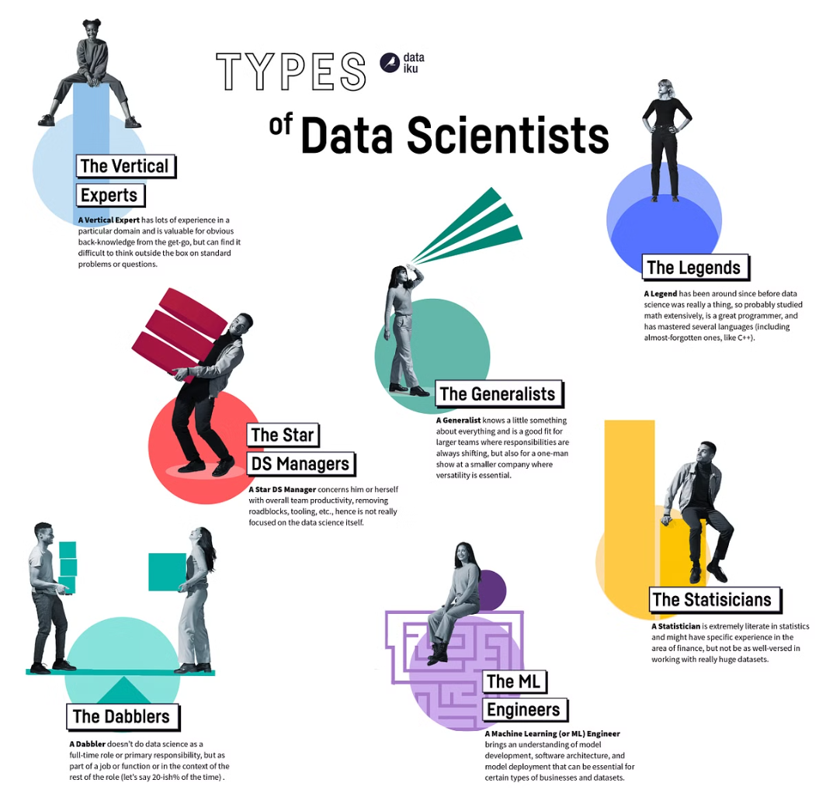
Data Preprocessing
Before training the machine learning model, the dataset undergoes a preprocessing phase to ensure its quality and suitability for analysis. This involves addressing issues such as missing values, encoding categorical variables, and scaling numerical features.
1
Missing Values
Handling missing values is crucial to maintain data integrity. Various imputation techniques can be employed to fill in missing data points.
2
Categorical Encoding
Categorical variables like gender, work type, and smoking status need to be converted into numerical representations for machine learning algorithms to process.
3
Data Scaling
Scaling or normalization of numerical features ensures that all features contribute equally to the model's learning process. This can be achieved using techniques like standardization or Min-Max scaling.
4
Train-Test Split
The dataset is split into training and testing sets. The training set is used to train the model, while the testing set is used to evaluate its performance on unseen data.

Slide 6

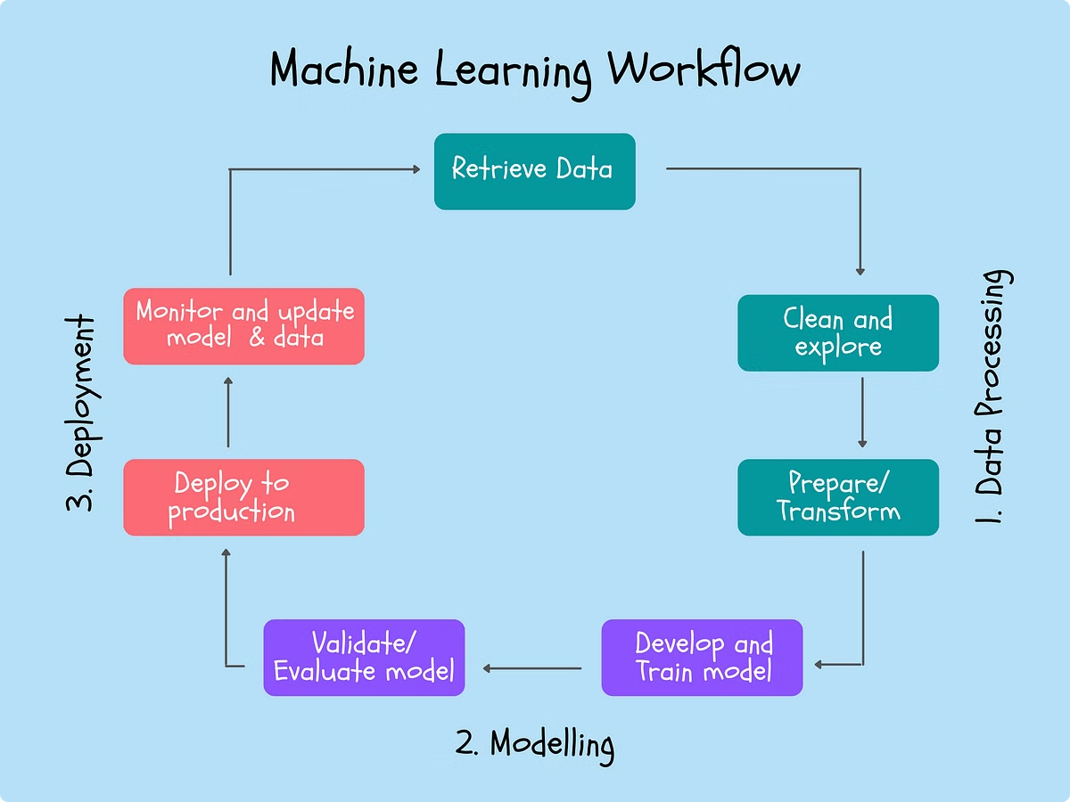
Machine Learning Model
The chosen machine learning model for this project is the Random Forest Classifier. Random Forest is an ensemble learning method that combines multiple decision trees to make predictions. This approach helps to reduce overfitting and improve model generalization.
Random Forest
Ensemble Learning
Random Forest is a powerful and versatile algorithm that can handle both numerical and categorical data. It is known for its robustness and good performance on various datasets.
Random Forest's ensemble nature, where multiple decision trees are combined, helps to improve the model's accuracy and stability by reducing variance.
Decision Trees
Decision trees are a fundamental building block of Random Forest. They make predictions based on a series of decisions, branching through the tree based on feature values.

Slide 7





Model Training & Evaluation
The Random Forest Classifier is trained using the prepared training data. The model learns patterns and relationships between features and the target variable (stroke status). After training, the model's performance is evaluated on the test set.
Training Data
The model learns from the training data, identifying patterns and relationships between features and the target variable.
Model Parameters
Various hyperparameters of the Random Forest algorithm are adjusted to optimize the model's performance during the training process.
Evaluation Metrics
Key performance metrics, such as accuracy, precision, recall, and F1-score, are used to assess the model's effectiveness on the test set.

Slide 8





Results
The trained model achieved a high level of accuracy in predicting brain stroke. The evaluation metrics show promising results, indicating the model's ability to effectively discriminate between individuals at risk of stroke and those who are not.
Accuracy
Precision
Recall
The model achieved a high accuracy score, indicating its ability to correctly predict both stroke and non-stroke cases.
Precision measures the model's ability to correctly identify stroke cases among those predicted as positive. A high precision score suggests that the model is reliable in identifying true stroke cases.
Recall measures the model's ability to identify all true stroke cases. A high recall score indicates that the model is effective in capturing all stroke cases.

Slide 9


Conclusion and Future Directions
The results of this project demonstrate the potential of machine learning in predicting brain stroke. The developed model exhibits promising performance, highlighting the value of data-driven approaches in healthcare.
1
Conclusion
2
Future Directions
3
Impact
The developed model demonstrates the potential of machine learning in predicting brain stroke, achieving high accuracy and valuable insights into stroke risk factors.
Future research can explore incorporating additional features, such as genetic information, to enhance the model's prediction accuracy and expand its applications in personalized medicine.
This project contributes to advancements in stroke prediction and ultimately aims to improve patient care by providing valuable tools for early intervention and prevention.

Slide 10
THANK YOU FOR JOINING ME

